Slide 1

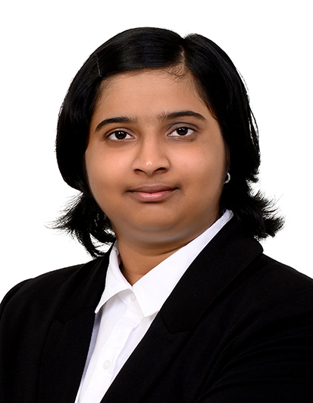
Deep Learning using Keras and Azure Notebooks
Vijaya Gajanan Buddhavarapu

Slide 2
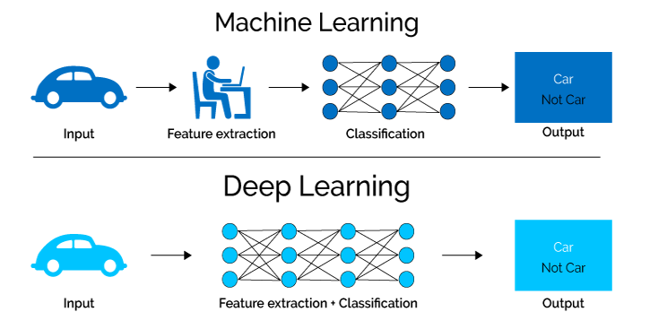
Deep Learning in a Nutshell

Slide 3
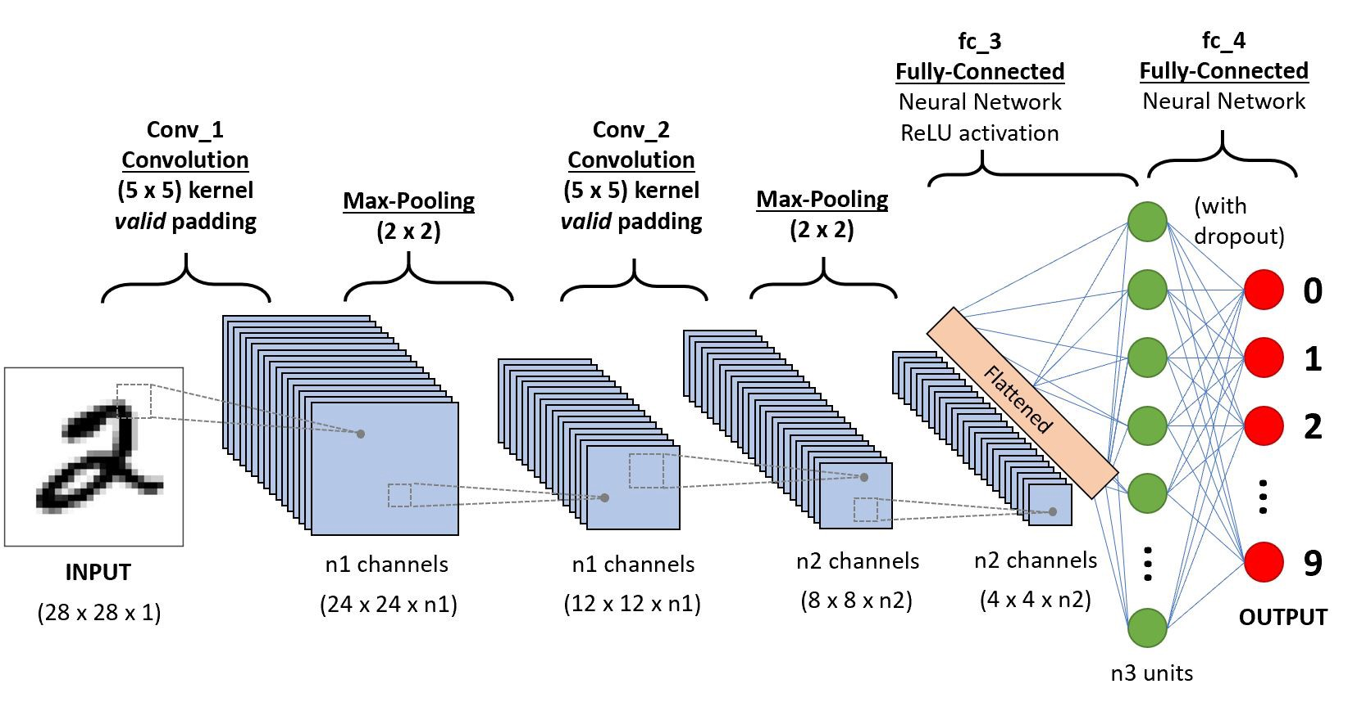
Convolutional Neural Networks

Slide 4
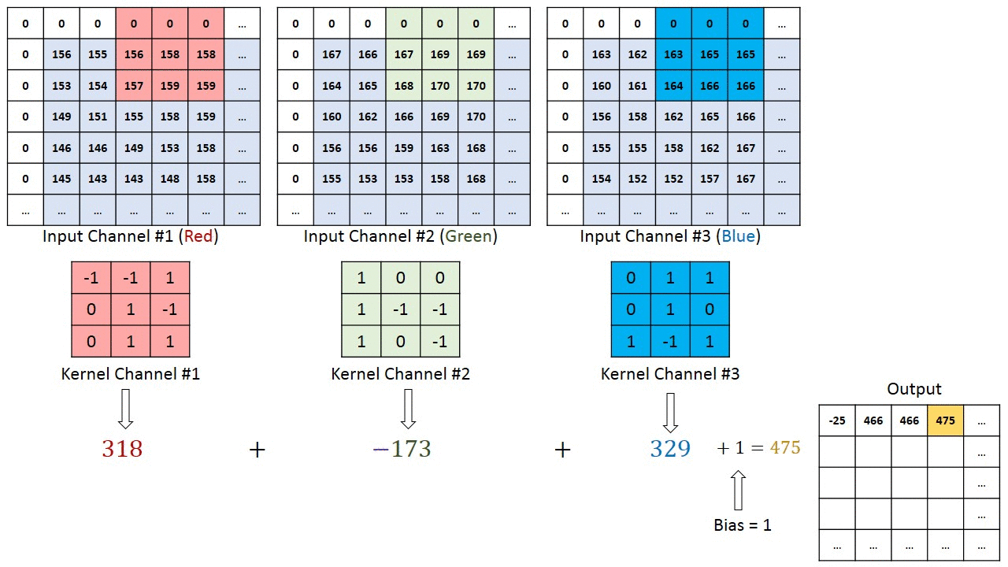
Convolutional Neural Networks

Slide 5
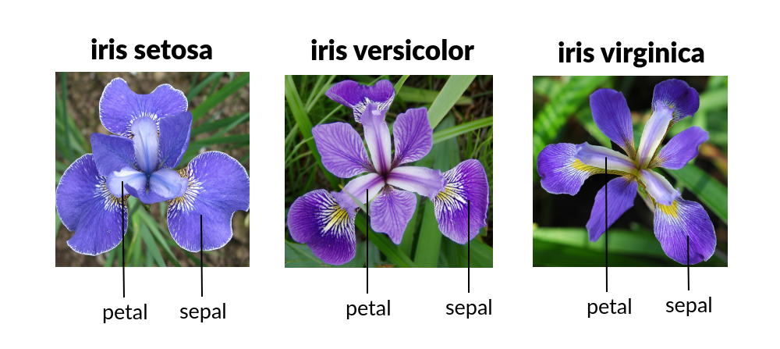
Today’s Practical: Create a CNN for Classification

Slide 6
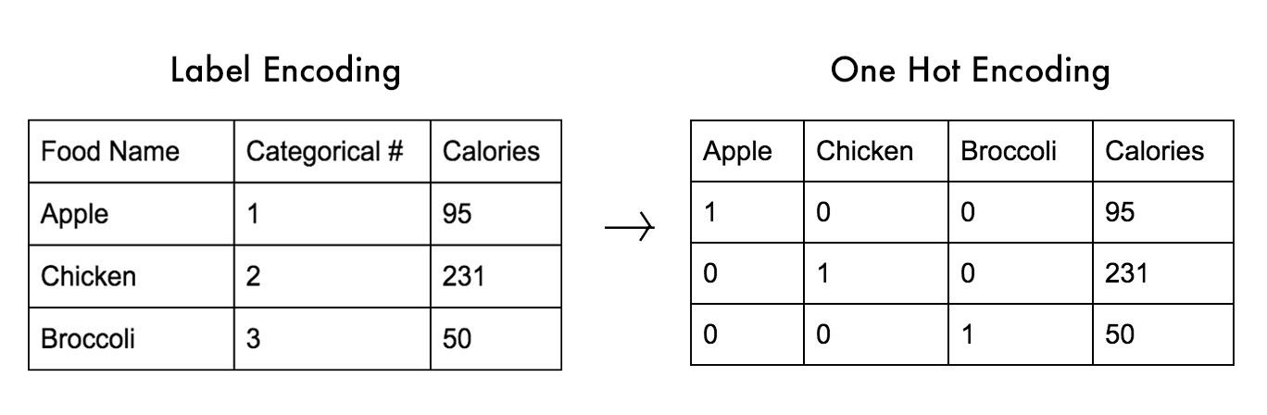
One Hot Encoding

Slide 7
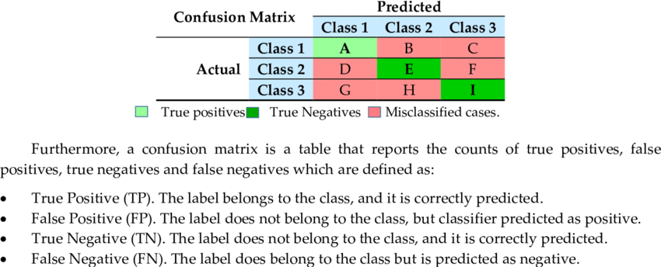
Confusion Matrix for 3 classes

Slide 8


